Slide 1

Synthesis of 2d Ti3c2tx mxene for electronic property analysis
Darius Hampton-Ross, Aerospace Engineering
Faculty Mentor: Kenan Song
Graduate Mentor: Sayli Jambhulkhar
School for Engineering of Matter, Transport, and Energy
NASA Space Grant Consortium Symposium
April 23, 2022

Slide 2


Introduction to mxene
MXenes are a class of graphene-like two-dimensional materials synthesized by the etching of MAX phase carbides and nitrides.
Although MXene has shown positive results, it suffers downfalls when it comes to their small flake size, surface defects, and harmful use of strong acids during synthesis.
The synthesis of ${Ti}_{3}C_{2}T_{x}$MXene is a developing multistage process that requires careful and methodical implementation.

Slide 3
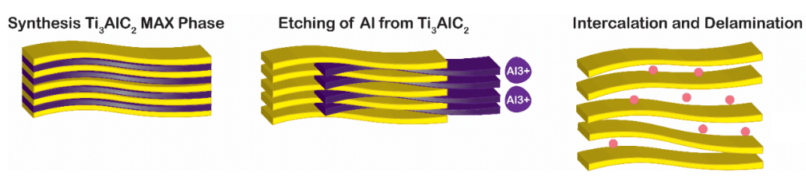
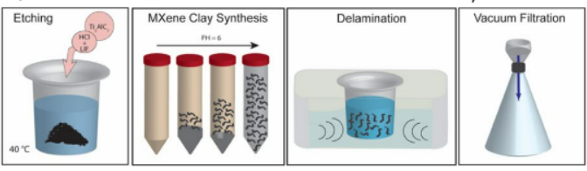

Synthesis MEthodology
The fabrication process involves four main steps: etching, washing, sonication, and separation.
Etching of Al from ${Ti}_{3}AlC_{2}$
Etching resulted in ${Li}^{+}$ ions in delaminated MXene layers
Utilized in situ HF etching, centrifuge washing, tip sonication, and vacuum filtration and drying to develop Mxene film.

Slide 4
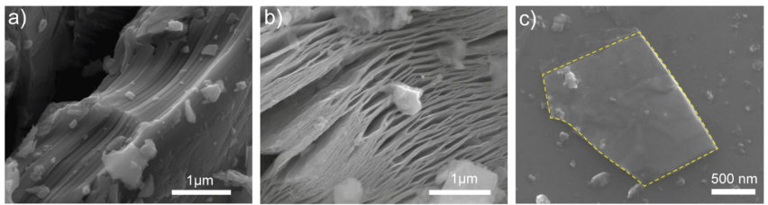

SYNTHESIS RESULTS
Successful etching and delamination stages led to the production of a promising flake size, and single-to-multi layer morphology suitable for further application
SEM images of MAX phase, delaminated MXene, and MXene flakes.
Darker layers are intercalated MXene, lighter spots are ${Li}^{+}$ and flake size fell around 1500 nm in length and around 1000 nm in width.

Slide 5
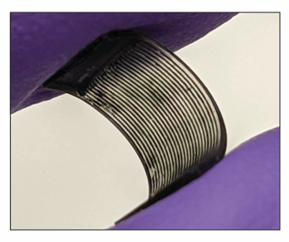
COATING METHODOLOGY
3D-Printed substrate was printed with grooves to allow for the deposition of Mxene into ridges, and shows the flexibility of Mxene coating.
Deposition of MXene into grooves
MXene film helped to show synthesis quality, but MXene coating generated by utilizing MXene before reaching the vacuum filtration stage.

Slide 6
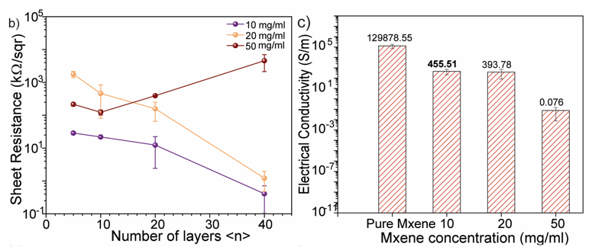
ELECTRONIC PROPERTY ANALYSIS
A multimeter was used in order to measure sheet resistance for several deposition layers, resistance data was then used to calculate conductivity for the 40-layer deposition
Sheet resistance and electrical conductivity for MXene deposition

Slide 7
Conclusions and future work
Pure MXene showed promising results in conductivity, and lower concentrations of MXene produced promising resistance values
Future applications could include testing in electromagnetic interference shielding, which could apply to a wide range of uses such as spacecraft plating materials

Slide 8
References and Acknowledgements
Aligned Ti3C2Tx MXene for 3D Micropatterning via Additive Manufacturing
Sayli Jambhulkar, Siying Liu, Pruthviraj Vala, Weiheng Xu, Dharneedar Ravichandran, Yuxiang Zhu, Kun Bi, Qiong Nian, Xiangfan Chen, and Kenan Song
ACS Nano 2021 15 (7), 12057-12068 DOI: 10.1021/acsnano.1c03388
Special thanks to my faculty mentor Kenan Song, graduate mentor Sayli Jambhulkhar, and the ASU/NASA Space Grant Program for providing me with this opportunity and helping me in completing the research.

